Slide 1
CyHELICS
Simulating Large-scale Power Grids and Cyberattacks using HELICS
Senior Design Team 28
Tyler Atkinson: Attack Design
Zach Hirst: Attack/Frontend Support
Thomas Keeshan: Transmission/Distribution Grid
Matt Nevin: EV Model/Energy Grid Support
Justin Templeton: Frontend/Docker/Network Design Support
Kaya Zdan: Helics Creation/Energy Grid Support
Client and Advisor: Dr. Gelli Ravikumar
Notes:
Kaya

Slide 2
Introduction
Electric Grid Team
Frontend and Dev-Ops Expert
Helics Infrastructure
Expert
Attack Team
Tyler Atkinson
Thomas Keeshan
Justin Templeton
Kaya Zdan
Zach Hirst
Matthew Nevin
Notes:
quick

Slide 3
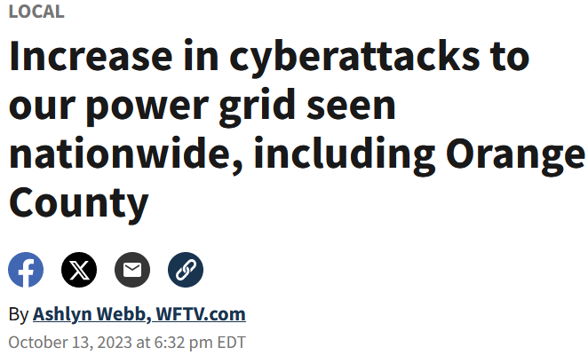
Background
Problem: Cyber attacks against the power grid cause significant damage. This damage includes outages, equipment damage, and standstill in sectors that rely on the power grid.
Solution: Creation of a tool to test the impact of cyber attacks against a simulated electrical grid.
Who does it help?
Utility companies
Power grid consultancies
City engineers and workers
The general population
Notes:
Matt (longer)
Public Health and Safety:
Can make grids more reliable by finding weak points.
Ensuring reliability helps to keep essential sectors that rely on the power grid to receive power at all times. Businesses include Hospitals, Police Stations,
Can be used to make pre fault plans that ensure the least amount of area is affected.
Optimize design to help reduce power outages.
Economic:
Can help utility companies save money by preventing outages and equipment damage which can cost a signifcant amount of money.
Global, Cultural, and Social:
Attacks can induce fear into the end users.
This can lead to issues with complaints

Slide 4
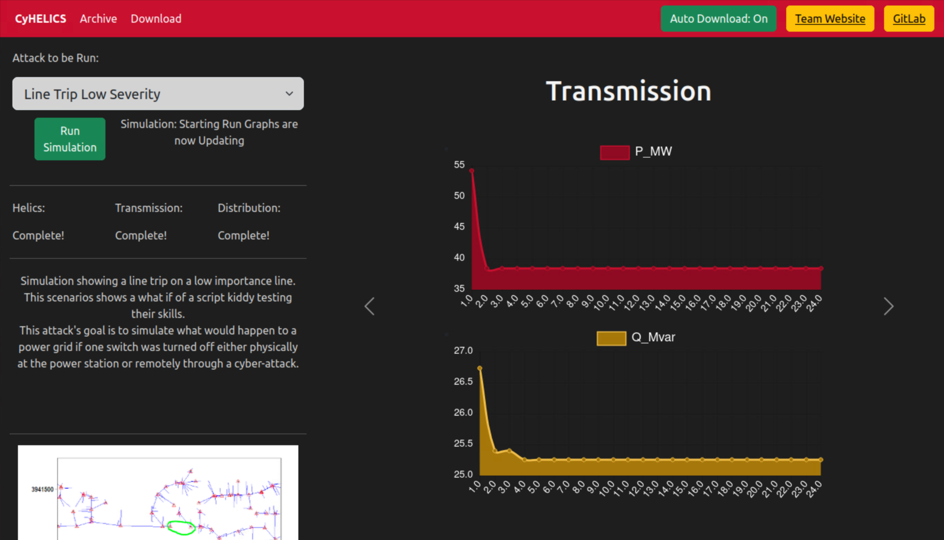
What is CyHelics?
A tool to emulate cyber attacks on a simulated electric grid model.
CyHelics uses 3 main software tools to run its simulations:
Pandapower
DSS-Python
Helics
The simulation data is displayed in graphs on the website. The graphs and CSV data can also be downloaded from the webpage.
Notes:
Kaya (longer)
CyHelics is a tool to test the impact of cyber attacks against an electrical grid, and help users enhance and validate security measures for their own electric grid. By using a simulated model, engineers and planners are able to visualize the real and reactive power as the grid is running, and see how cyber attacks against specific lines on the grid will impact them.
Our example of CyHelics is simulating the Santa Fe distribution model from BetterGrids.org. CyHelics uses 3 main open source projects to run. Pandapower, dss-python, and helics co-simulation. A typical electric grid requires a transmission system, and distribution system to run, and we used these 3 programs to simulate that.
When you’re ready to run the simulation, you can pick the attack, or no attack on this dropdown, there’s a small description of the attack here, and when you’re ready you can run the simulation. The graphs won’t be there before it starts, but as the simulation runs the graph will become populated with the results of the grid simulation.

Slide 5
Requirements
Design
Grid
The simulation will be tested in a VM environment.
The simulation will be set up in a dockerized environment.
The user must be able to select what attack to use in the flask front end.
The EV load profile will be connected as a load on the Santa Fe distribution grid.
Power Grid will include multiple load types.
Distribution Grid must have at least 50,000 nodes.
Create & simulate a simple transmission grid.
Use HELICS to combine multiple substream programs and run concurrently.
Use HELICS to model a 500 electric vehicle load profile within Sante Fe.
Attacks
Frontend
There must be at least one attack.
The attacks must have various severity levels.
The attacks will be focused with an emulation perspective.
Show results of simulation.
Frontend must have downloadable packages for results.
Frontend must have an archive mode to quickly look at effects of cyber attacks.
Frontend must have a continuous graph.
Notes:
Kaya (quick)
These are the overall requirements that we defined and met. To summarize, our simulation will be setup using docker and a VM, there must be a simple to use user interface to run the application, the grid must run using the Santa Fe model, there needs to be multiple load types, ideally including electric vehicles, and there must be at least one type of attack.

Slide 6
Implementation Details

Slide 7
Electric Grid Design Overview
Frontend Web Page
Web page displays true and reactive power from the simulation.
DSS-python is used to run the Santa Fe distribution model from BetterGrids.org.
Helics is the communication between grid programs, and handles the EV simulation.
Pandapower simulates a transmission system.
Grid Simulation
The simulation systems are run within individual Docker images running Ubuntu.
Notes:
Tommy (quick)
The simulation systems are run within individual Docker images running Ubuntu.
Pandapower simulates a transmission system.
DSS-python is used to run the Santa Fe distribution model from BetterGrids.org.
Helics is the communication between the two.
The resulting data gets sent to the frontend and displayed in graphs for the user. The graphs and CSV data can also be downloaded from the webpage.

Slide 8
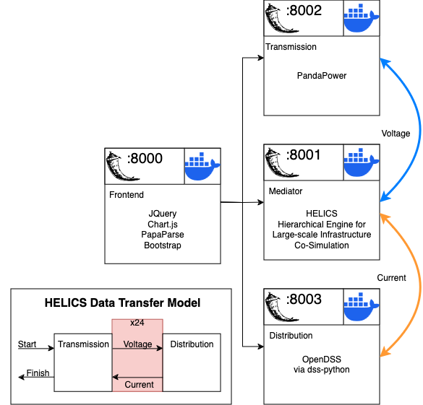
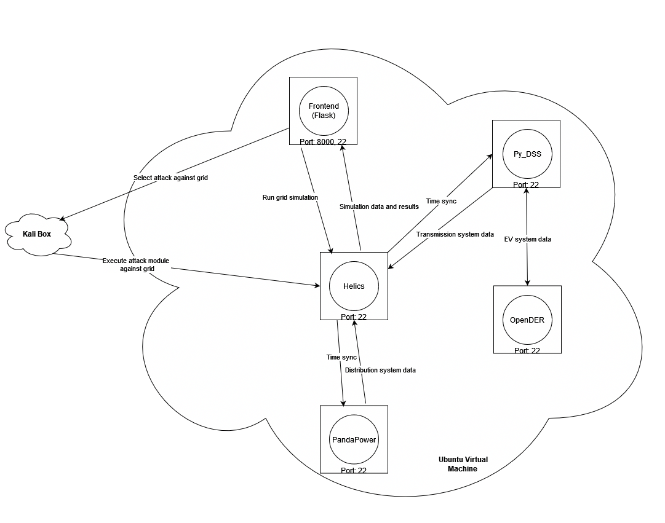
Docker Design Diagram
Current
First
Notes:
Justin (longer)

Slide 9
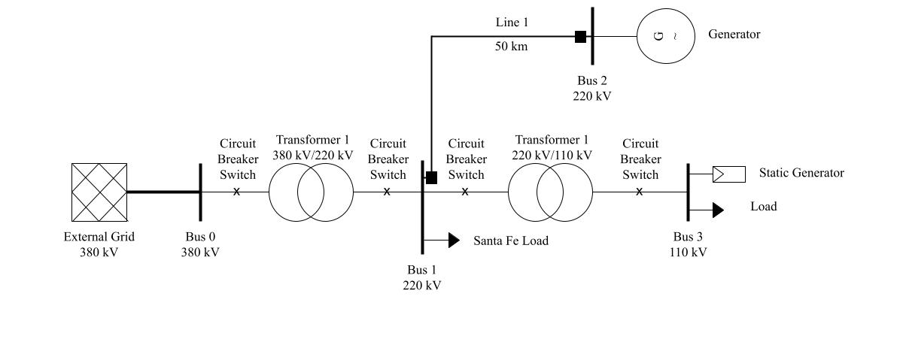
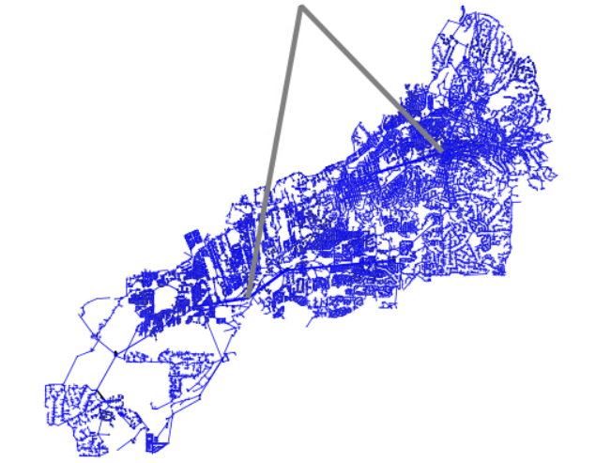
Electric Grid Model
Transmission simulation - PandaPower
Distribution simulation - DSS-Python
Santa Fe distribution model from BetterGrids.org.
Helics is used to facilitate the communication between the two softwares and simulate electric vehicle load profiles
HELICS
Notes:
Tommy (longer)
Helics intialization
Panda power model rundown
pandapower load
interconnection to distribution
components of distribution (node #)
Send back to xrmf
EV connection

Slide 10
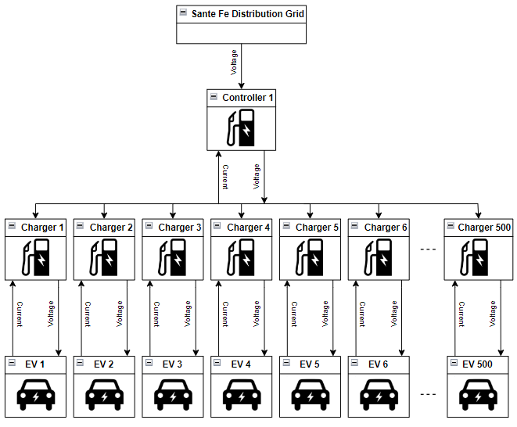
EV Model
The load profile consists of:
500 electric vehicles
500 charging stations
A singular controller that is connected to the Santa Fe distribution grid
Notes:
Matt (longer)
The electric vehicle load profile consists of 500 electric vehicles. Each of the electric vehicles have their own respective charging station. These 500 chargers are all controlled and regulated by a single controller that is directly connected to the Santa Fe distribution grid. The controller regulates the voltage being supplied to each charger and keeps track of the power consumption of the load. The chargers supply this voltage to each electric vehicle battery. There are three charging levels that include Level 1 at 120V, Level 2 at 240V, and Level 3 at 480V. These charging levels are assigned by percentages based off of real Santa Fe electric vehicle load profiles from the US Department of Energy. Each electric vehicle battery is assigned a randomly generated SOC that indicates how long it will need to charge and how much power it will consume. The SOC is the state of charge and quantifies the amount of charge left in the battery. The SOC and charging level are used to calculate the power draw from all 500 chargers over a 24 hour period. The electric vehicle battery also draws a current from the charger which is then sent back to the controller through the charger. This data is sent through DSS-python and transferred with Pandapower to update the load on the transmission grid.

Slide 11
Attacks
Data Integrity Attacks
Denial-of-Service Attacks
Ramp Attacks
Maliciously manipulates measurements or control signals
Severity - High
Maliciously causes a slowdown of grid infrastructure
Severity - Low
Maliciously causes a large power imbalance at the generator
Severity - Moderate
Notes:
Tyler (quick)

Slide 12
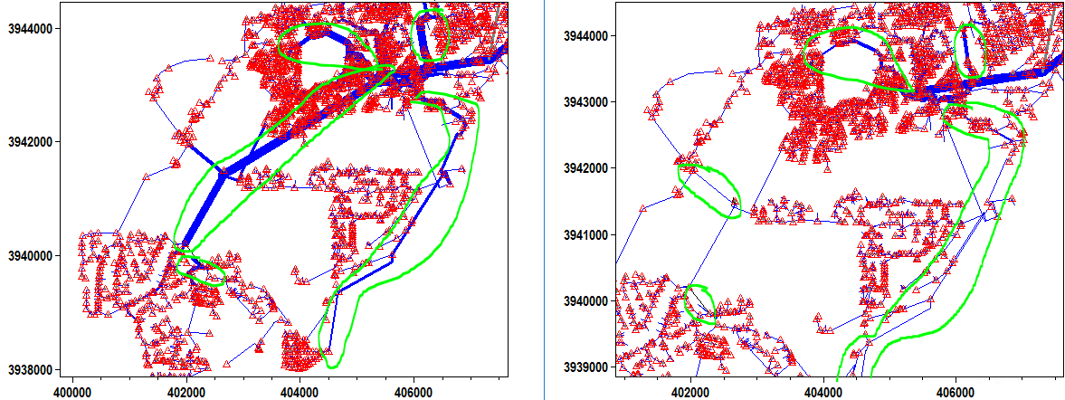
How we attack our grid
Constraints with the Dockerized environment means emulation instead of simulation.
Came up with 3 different types of attack outcomes focused on the electric grid:
Selective line tripping (low, medium, and high severity)
Generator short-circuit
Load-Shedding
Notes:
Tyler (longer)

Slide 13
Security Concerns and Countermeasures
Malicious actors can see where faults are in the power grid.
Application is offline, no way to breach it from the internet.
Application is dockerized - limiting its malicious use on a host computer.
Notes:
Tyler (quick)
Could target specific lines for attacks.
Security shouldn’t depend on this tool not being public.
Mitigation not Obfuscation!

Slide 14
Testing Process
System and End-to-End Testing
Check if Flask Applications are active.
If there are conflicts or basic errors, HTTP requests will fail.
Integration Testing
Check for simulations returning error codes
If the simulation fails, an error code will be produced to the http request that called it.
Notes:
Zach (longer)
Our testing process includes integration and system-end testing. Wanting to prevent a program crash we looked for weaker points in our design in terms of the software breaking.
We saw benefits from checking that our flask apps were running and returning positive status codes. Additionally, we want to make sure flask is installed on each docker image. The goal with these tests is to avoid a flask startup error which would affect the manipulation and display of information on our simulation.
The integration testing is geared toward checking each individual docker image. Ensuring docker specific programs such as HELICS, panda power, and dss python are installed upon each program start. Looking for each program to post a positive status code

Slide 15
Conclusion

Slide 16
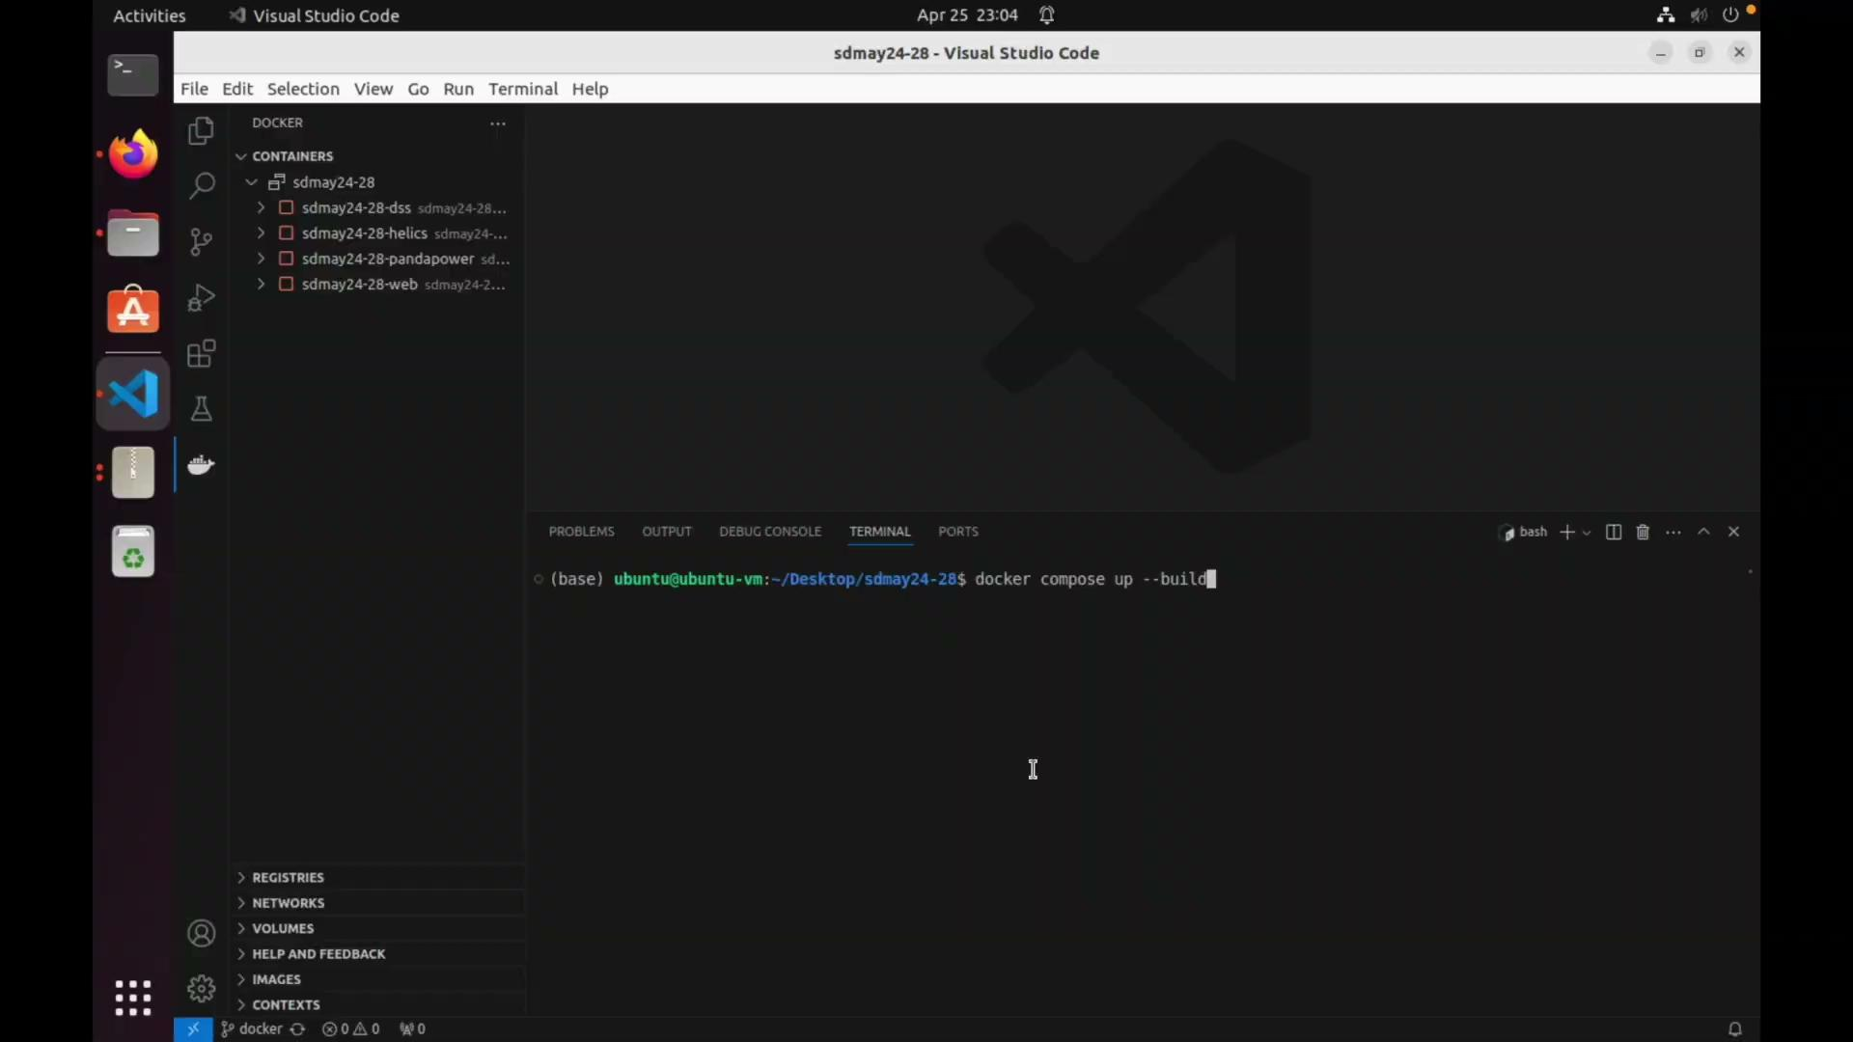
Demo
Notes:
(longer)

Slide 17
Progress Review
Design
Grid
The simulation will be tested in a VM environment.
The simulation will be set up in a dockerized environment.
The user must be able to select what attack to use in the flask front end.
The EV load profile will be connected as a load on the Santa Fe distribution grid.
Power Grid will include multiple load types.
Distribution Grid must be have at least 50,000 nodes.
Create & simulate a simple transmission grid.
Use HELICS to combine multiple substream programs and run concurrently.
Use HELICS to model a 500 electric vehicle load profile within Santa Fe.
Attacks
Frontend
There must be at least one attack.
The attacks must have various severity levels.
The attacks will be focused with an emulation perspective.
Show results of simulation.
Frontend must have downloadable packages for results.
Frontend must have an archive mode to quickly look at effects of cyber attacks.
Frontend must have a continuous graph.
Notes:
Zach (quick)
Looking at the requirements given to us at the beginning of the semester

Slide 18
Future Development
EV
Integration of the electric vehicle load profile into the Santa Fe distribution model.
Power Grid Variable Load
Implementing variable loads over a 24 hour period on the Santa Fe distribution model.
Various Grids
Implementing the ability to upload and use a custom distribution model.
Transmission Grid
Creating a more accurate PandaPower transmission grid
More Attacks
Implementing more cyber attacks - short circuit, botnet DoS, etc.
Frontend database
Implement a database for archive mode data.
Notes:
Tommy (quick)

Slide 19
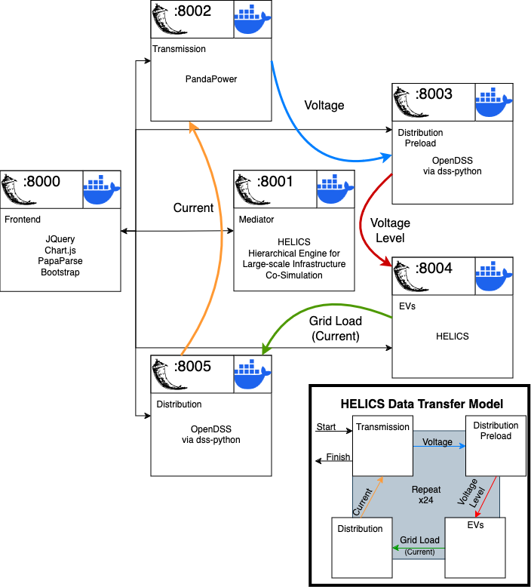
Future Docker Design
Future
Current
Notes:
Justin (quick)

Slide 20
Thank You

Slide 21
Sources
https://spectrumlocalnews.com/tx/south-texas-el-paso/news/2023/12/11/report--chinese-hackers-targeted-texas-power-grid--hawaii-water-utility--other-critical-infrastructure-
https://www.politico.com/news/2023/09/10/power-grid-attacks-00114563
https://www.reuters.com/technology/cybersecurity/us-electric-grid-growing-more-vulnerable-cyberattacks-regulator-says-2024-04-04/
https://www.wftv.com/news/local/increase-cyberattacks-our-power-grid-seen-nationwide-including-orange-county/J4AP76IZLZBKHADGYXXOMEIMWM/
https://clipart-library.com/img/1851344.png
https://www.pinclipart.com/picdir/big/14-147675_hat-clipart-builder-construction-worker-helmet-clipart-png.png
https://static.vecteezy.com/system/resources/previews/005/089/757/original/webpage-icon-style-vector.jpg
https://www.flaticon.com/free-icons/attack
https://afdc.energy.gov/evi-x-toolbox#/evi-pro-ports

Slide 22
Broader Context
Public Health and Safety:
Can make grids more reliable by finding weak points.
Can be used to make post fault plans to ensure the least amount of area is affected.
Optimize design to help reduce power outages.
Economic:
Saves money by helping optimize grid design.
Environmental:
Other industries depend on the power grid to Continue running.
Costs compound based on users.
Global, Cultural, and Social:
Attacks induce fear into Grid users.
Notes:
Add cyber attack map or power outage map

